Slide 1
TOPIC

Slide 2
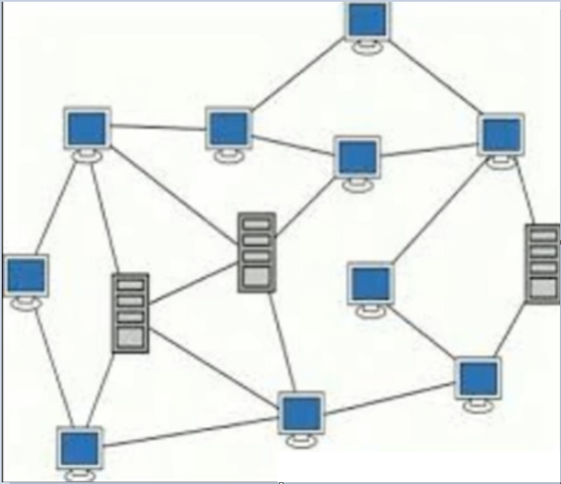
COMPUTER NETWORK
Group of computer systems
Computing hardware devices
Linked together with wire or wirelessly
Communication
Resources
(Hardware +Software )

Slide 3
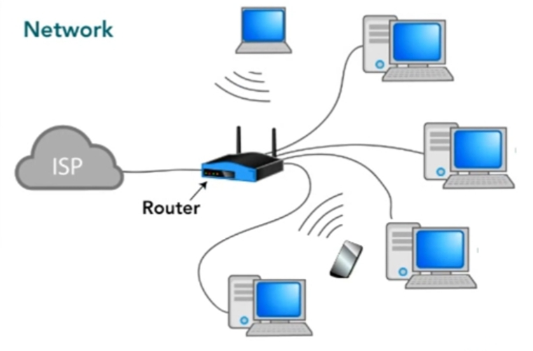
EXAMPLES
1. HOME NETWORK
1.What is ISP?
2. What is Modem?
3. What is Ethernet?
5. What is Wi-Fi?
6. What is Router?

Slide 4
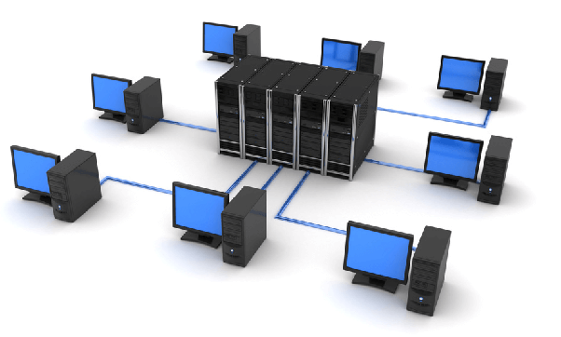
2. OFFICE NETWORK

Slide 5
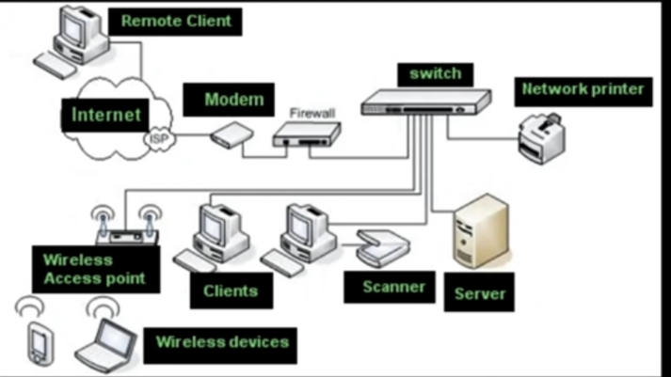
Advantages of Network
ADVANTAGES
1. Efficient management of
Data and file sharing
2. Sharing Media
3. Resource sharing of hardware
4. Increased Storage Capacity
5. Speed

Slide 6
DISADVANTAGES
1. Cost of network
2. Security Hacking
3. Virus
4. Lack of Independence Depend

Slide 7
CLIENT / SERVER NETWORK

Slide 8
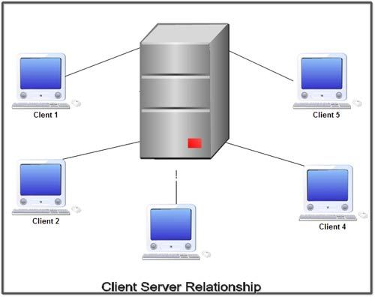
Client / Server Network
Client
Any computing device
need services
makes Request
Server
A special computer
Serves client

Slide 9
Example

Slide 10
TYPES OF NETWORK

Slide 11
Types Of Network
TYPES:
LAN: Local Area Network Area
MAN: Metropolitan Area Network
WAN: Wide Area Network

Slide 12
LAN: Local Area Network

Slide 13
MAN: Metropolitan Area Network

Slide 14
WAN: Wide Area Network

Slide 15
Types Of Computer Network

Slide 16
TRANSMISSION MEDIA

Slide 17
TRANSMISSION MEDIA:
Transmission Media is a pathway that carries the information from sender to receiver.
We use different types of cables or waves to transmit data.
Data is transmitted normally through electrical or electromagnetic signals.
Transmission media is also called Communication channel.

Slide 18
TYPES OF TRANSMISSION MEDIUM
There are Two Types of Transmission Media, namely guided and unguided.
1. Guided Media is a wired communication it transmits data either using twisted pair cable, coaxial cable or fiber optics.
2.Unguided Media is a wireless communication it transmits signal by broadcasting it through the air.
TYPES:

Slide 19
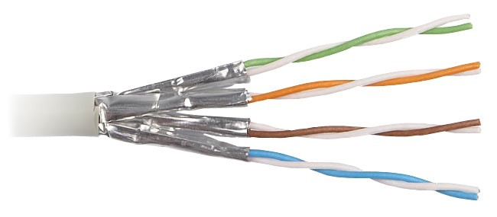
1. TWISTED PAIR CABLE
Pair of insulated wires
2 million bits per second
10 billion bits per second
Remove Noise
Electromagnetic Interface
Cross Talk

Slide 20
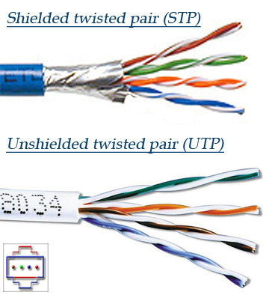
Types Of Twisted Pair Cable
Shielded Twisted Pair (STP)
Unshielded Twisted Pair (UTP)

Slide 21
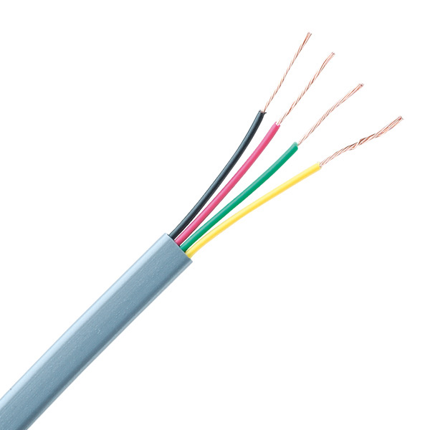
Telephone Line
2 Pairs
4 Wires

Slide 22
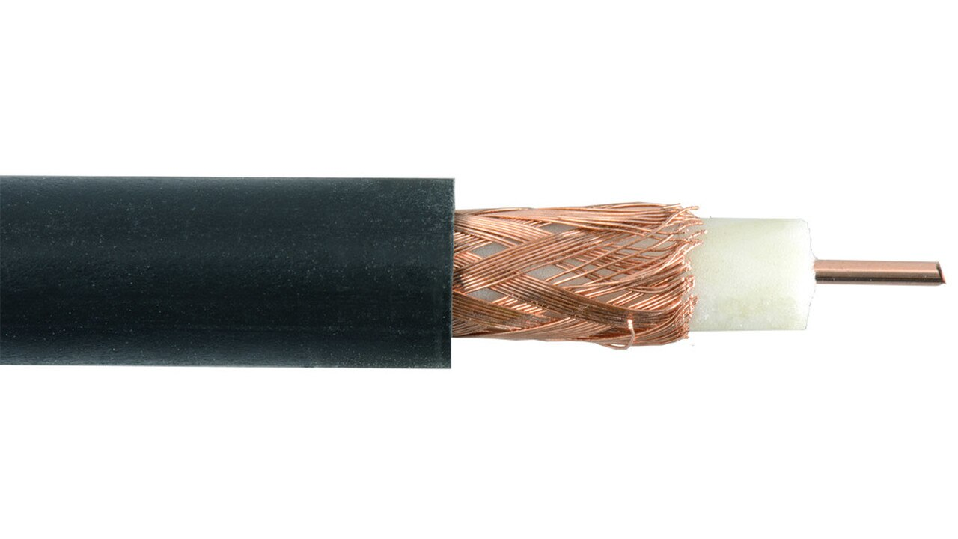
2. COAXIAL CABLE
Wire Communication
Electrical Signals
Electromagnetic Interference
200 million bits per second
500 million bits per second
Used in different organization

Slide 23
EXAMPLE

Slide 24
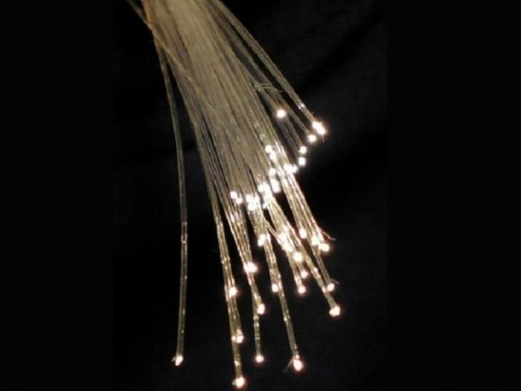
3. FIBER OPTIC CABLE
Communication Medium
Transmit data
Light waves
Transparent Strand
Thin Hair Fast Speed
Pure Glass 50,000 communication lines

Slide 25
EXAMPLE

Slide 28
MICROWAVE
Microwave Electromagnetic Radiation
Wave length = 1 meter to 1 mille meter
Speed : 16 Giga bits per second
Pass through obstacle: Wall, Building

Slide 29
EXAMPLE

Slide 30
RADIO WAVE AND INFRARED
Radio waves
Microwave
Infrared
Electromagnetic waves
Bluetooth
Wi-Fi

Slide 31
EXAMPLE

Slide 32
CUTTING EDGE TECHNOLOGIES

Slide 33
Cutting Edge Technologies
CUTTING EDGE TECHNOLOGIES
Cutting Edge Technologies is the most advanced developments in the computer technology.
The following are a few cutting edge technologies in the field of networks and communication.
Cellular Communication
Satellite Communication
Global Positioning System
Bluetooth

Slide 34
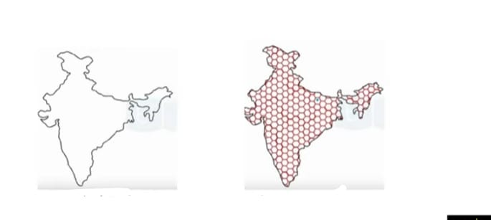
1. Cellular Communication
CELLULAR COMMUNICATION
Divide area
Cells – hexagonal shape

Slide 35
i. Base station (BS)
ii. Transceiver
iii. base controller + Master controller

Slide 36
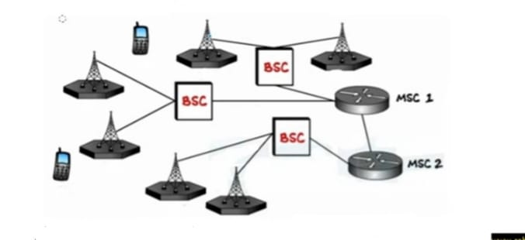
Radio frequency (channel)

Slide 37
2. Satellite Communication
SATELLITE COMMUNICATION
Satellite Revolves around the earth
Natural Satellite Moon
Artificial Satellite
Path Orbit
2,000 Communication Satellite
Radio and Microwave Frequencies

Slide 38
EXAMPLE

Slide 41
3. Global Positioning System
GOLOBAL POSITIONING SYSTEM
GPS
Radio navigation system good maps
Exact position A B
On land
In air
24 hours a day
In all weather conditions

Slide 42
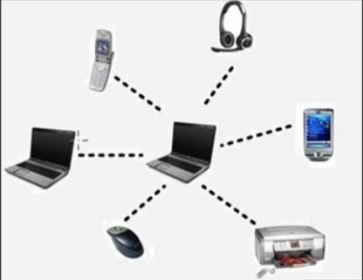
4. Bluetooth
BLUETOOTH
Short Distance
Wireless Communication
Radio Waves
200 meter Free
Pairing
Peer Bluetooth networking devices

Slide 43
UNIT#02
COMPUTER SECURITY AND THREATS

Slide 44
QUESTION#1
What is the importance of Information Security?

Slide 45
INFORMATION SECURITY
1. Field of Computer Science
2. Design Strategies to project information
3. Present in Computer Systems from unauthorized Access
4. Natural disaster

Slide 46
IMPORTANCE OF INFORMATION SECURITY
Most important organization assets
EXAMPLE
Financial and Medical Records
Social Media Posts
Photos and videos
User Name and Password

Slide 47
Principles of Information Security
QUESTION#2
Explain Three principles of information security.
1. CONFIDENTIALITY
Information can only be seen by user
Example
ATM Password
2. INTEGRITY
Information cannot be changed with user permission

Slide 48
Example
Bank SMS Alert
3. AVAILABILITY
Information is available when user need
Example
Bank Account Balance

Slide 49
COMPUTER VIRUS
QUESTION #3
What is computer VIRUS?
COMPUTER VIRUS
It is a software.
It is self replicating means it makes copies of itself.
It is designed to be non-detectable.
QUESTION #4
Explain in how many ways VIRUS can be classified?
VIRUS can be classified in many ways..
Malicious Neutral Helpful

Slide 50
1. Malicious
Most famous of the viruses.
They may destroyed or broadcast private data.
They may make Microprocessor very busy and stop it from doing useful work.
2. Neutral
They may display harmless messages.
3. Helpful
They may hop from one computer to another while searching for and destroying malicious viruses.

Slide 51
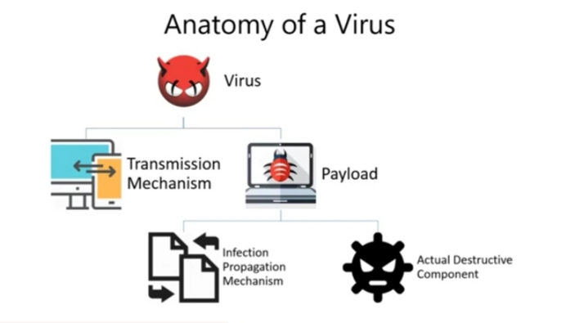
QUESTION #5
Explain Anatomy of virus?

Slide 52
QUESTION #6
How do viruses spread?
Infected Removable Drive such a USB Flash Disk, CD-ROM, DVD-ROM etc.
The internet by downloading infected files or email attachments.

Slide 53
QUESTION #7
How to protect from Virus?
Download software from trusted websites only.
DO NOT open attachment from unknown emails.
Use a removable drive (USB Flash Disk/CD/DVD) that have been used in trusted computers.
Regularly backup your data.
Install Antivirus software, keep it and virus definition updated.

Slide 54
QUESTION #8
Write the names of the following types of threats?
Types of Threats
Computer security can have the following types of threats.
Error and omissions
Fraud and theft
Employee sabotage
Malicious hackers
Malicious code

Slide 55
QUESTION#9
What are the common security threats?
Common Security Threats
The following are some common security threats.
1. Virus 2. Adware 3. Worms 4. Spyware

Slide 56
QUESTION#10
Explain all the Common Security Threats?
or
Explain all the Types of Malware.

Slide 57
TYPES OF MALWARE
There are Four main Types of Malware.
i.WORMS ii. SPYWARE iii. ADWARE AND iv. VIRUS

Slide 58
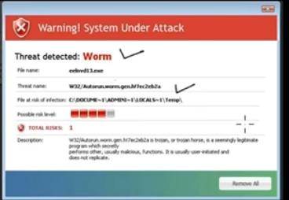
WORM
Program
Operating System Weakness
Over a network
Transmit Replicate
Automatically
Infect other computers

Slide 59
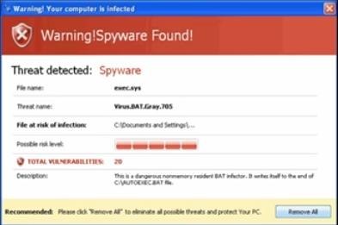
SPYWARE
SPY on user computers
Gathering Information
Available
Internet
Install Software
Stealing Password

Slide 60
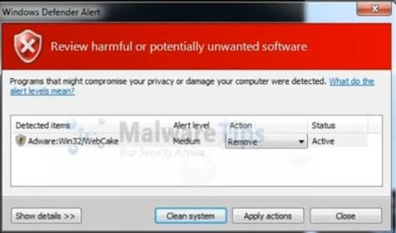
ADWARE
Free Software

Slide 61
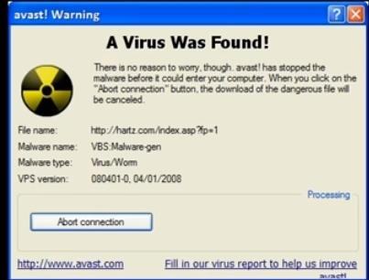
VIRUS
Inserting a copy
Another program
Spread
Execution Files
One computer to another
USB Flash drive
CD/DVD

Slide 62
QUESTION#10
Explain all the Common Security Threats?
1. Computer Virus
A computer virus is a program.
A virus replicates and executes itself, usually doing damage to your computer in the process. Carefully evaluating free software, downloads file sharing sites, and Emails from unknown senders are crucial to avoiding viruses.

Slide 63
2. ADWARE
Adware (short for advertising-supported software) is a type of malware that automatically delivers advertisements.
It is a software that generates revenue for its developer by automatically generating online advertisements in the user interface of the software or on a screen presented to the user during the installation process.
Common examples of adware include pop-up ads on websites.

Slide 64
3. SPYWARE
Spyware is a type of malware that functions by spying on user activity without their knowledge and send such information to hack another entity without the consumer's consent.
Spyware asserts control over a device without the consumer's knowledge, sending confidential information to another entity with the consumer's consent, through cookies.

Slide 65
4. WORMS
A computer worm is a standalone malware computer program that replicates itself in order to spread to other computers.
Worms almost always cause at least some harm to the network, even if only by consuming bandwidth, whereas viruses almost always corrupt or modify files on a targeted computer.
Many worms are designed only to spread, and do not attempt to change the systems they pass through.

Slide 66
QUESTION#11
How is a virus different from worms?
The difference between a virus and a worm is that viruses must be triggered by the activation of their host; whereas worms are stand-alone malicious programs that can self-replicate and propagate independently as soon as they have breached the system.

Slide 67
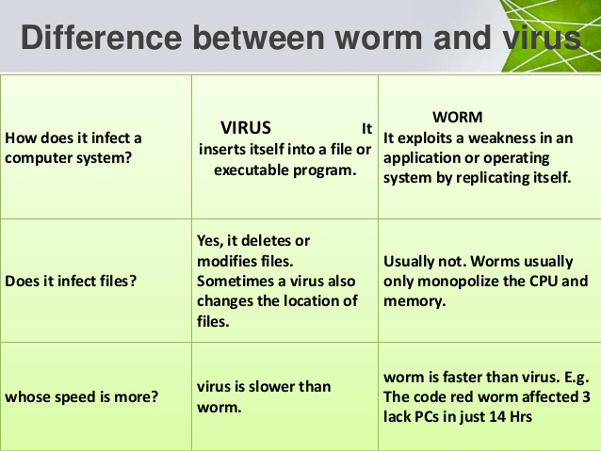
QUESTION#12
Difference between virus, worms adware and spyware.
Difference between Virus and worms

Slide 68
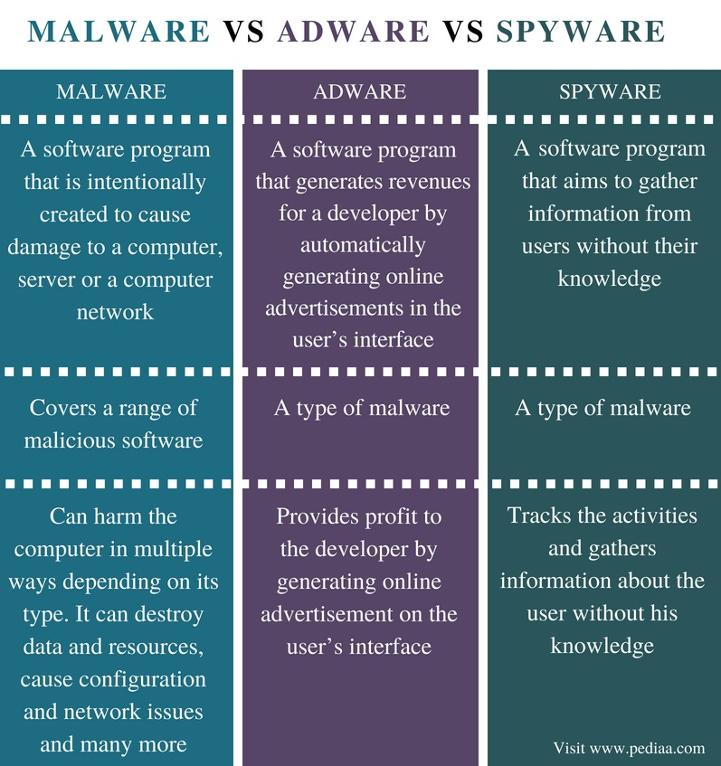
Difference between Adware and spyware

Slide 69
QUESTION#13
Why do criminals hack others computers?
When someone hacks a computer or network system, it's usually for one of three main reasons:
1. Hacking for fun
Some hackers make attempts on computers, servers, or network systems for the personal gratification.
Others may feel that they need to prove something to their peers or friends, and hack something only for the challenge.

Slide 70
2. Hacking to steal
Another reason to hack a system is to steal information or money. A large portion of hacking attempts fall into this category. Banks and large companies are common targets for hacking jobs, but sometimes smaller companies or even a specific person's computer are targeted, as well
3. Hacking to disrupt
There are also some hackers, including hacking groups, that target a company to disrupt business.
These groups often try to make a statement with their hacking, demonstrate security inadequacies, or show general disapproval for the business itself.

Slide 71
QUESTION#14
How Viruses, worms, and adware spread? OR
Write down the ways Malware spreads.
Viruses, worms, malware and adware spread in the following ways.
Infected flash drives or floppy disks
Email attachments
Suffering insecure websites
Installation of pirated software

Slide 72
QUESTION#15
Define vulnerability, threat and countermeasure.
Vulnerability comes from the Latin word for "wound," vulnus. Vulnerability is the state of being open to injury, or appearing as if you are.
Vulnerability is the quality of being easily hurt or attacked.

Slide 73
Vulnerability Example
Vulnerability is a weakness or some area where you are exposed or at risk. If you are running for political office and you don't want anyone to find out about a scandal in your past, the scandal is an example of a vulnerability.

Slide 74
Threat
Security Threat is defined as a risk that which can potentially harm computer systems and organization. The cause could be physical such as someone stealing a computer that contains vital data. The cause could also be non-physical such as a virus attack.
There are several types of computer security threats such as Trojans, Virus, Adware, Malware, Rootkit, hackers and much more. Check some of the most harmful types of computer Security Threats

Slide 75
Countermeasure
In computer security a countermeasure is an action, device, procedure, or technique that reduces a threat, a vulnerability, or an attack by eliminating or preventing it, by minimizing the harm it can cause, or by discovering and reporting it so that corrective action can be taken.

Slide 76
QUESTION#16
Define what is Antivirus Program?
Antivirus Program
An Antivirus is a program that searches a computer for malicious software and removes them. Each computer must have a good quality registered antivirus program installed in it.

Slide 77
QUESTION#17
What facilities does an Antivirus program offer?
Virus Detection
System Analysis
Malware Removal
File Quarantine
Threat Identification
Online Security
Data Protection

Slide 78
QUESTION#18
Which of the following is an antivirus program?
There are many Antivirus developers. Some famous antivirus programs are:
1. Norton
Norton antivirus programs are developed by Symantec.
McAfee
McAfee distribute a number of antivirus program for home, professional and
business purposes.
AVG
AVG distributes AVG Anti-Virus for free.
4. Microsoft Security Essentials
Microsoft Security Essentials is a free antivirus and malware remover. It is
distributed by Microsoft for windows operating systems.

Slide 79
QUESTION#19
Write the names of the following types which are used to scanning a computer for viruses?
following options are used to scanning a computer for viruses:
Quick Scan
Full system scan
Removable media scan
Folder scan
File scan

