Slide 1
BAHRIA COLLEGE ISLAMABAD
GENERAL SCIENCE
(new lower secondary science 1)
CLASS VII
MISS IQRA AKRAM

Slide 2
FIRST TERM SYLLABUS
UNIT 9: Elements
UNIT 10: Compounds or Mixtures
UNIT 11: Separating Mixtures
UNIT 12: Air Pollution

Slide 3
Element the simplest kind of matter pg# 100
What is matter?
Ans: Any thing that
occupy space
and has weight
is called matter.

Slide 4
PROPERTIES OF SOLID LIQUID AND GAS

Slide 5
QNO1: what do you know about elements? ELEMENTS: 1. all matter on earth consist of four elements. 2. Scientist have identified 90 naturally occurring elements, and created about 28 others. Pg# 101

Slide 6
QNO2: what is an element? Name five things which are made up of elements? Pg#101
Ans: Elements: An element is a substance Which cannot be split into two or more Simpler substances by chemical reaction.
For example: book, apple, shoes, water, juice.
QNO3: what are the most abundant element in the universe and the earth crust?
Ans: the most abundant element in the universe is Hydrogen and helium and the most abundant element in the earth’s crust is oxygen.

Slide 7
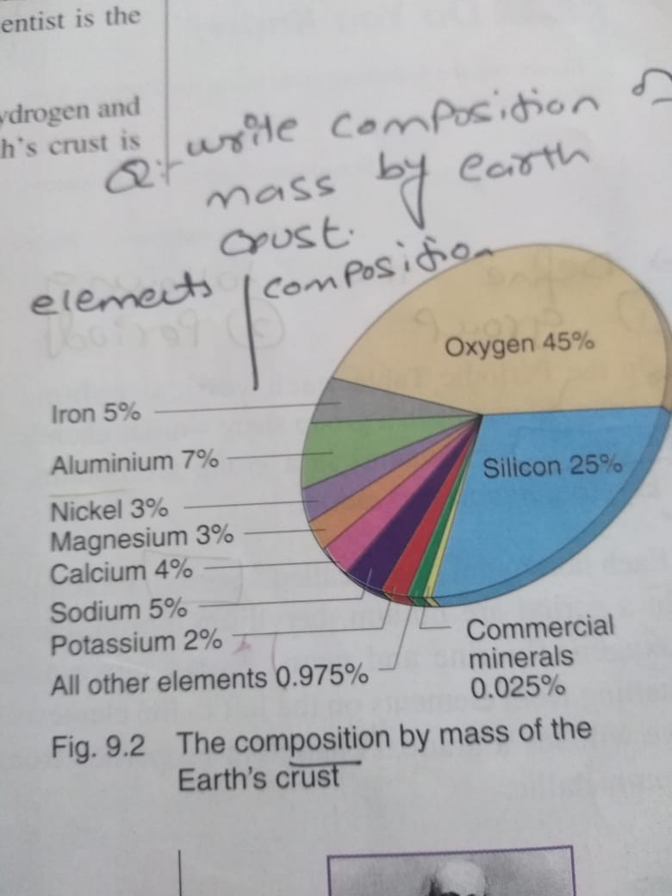
Qno4: write composition by mass of the earth crust? Pg#101

Slide 8
Pg#101 qno5:how elements can be classified? Classification of elements scientists like Mendeleev have classified elements into a chart called the periodic table.

Slide 9
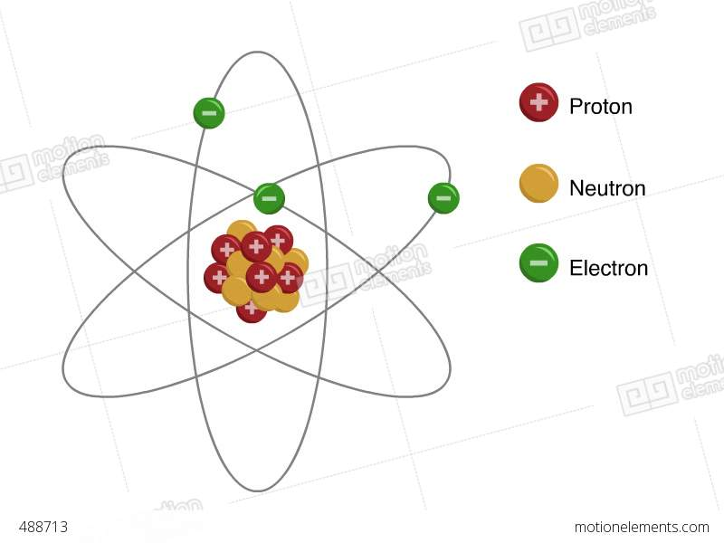
Subatomic and Atomic level
All types of mater are made up of elements.
Each Element contain single atom
Atom= not cut
Sub-atomic particles
Proton, neutron, electron

Slide 10
Structure of an Atom

Slide 11
Pg#102 Qno6: How elements can arranged into periodic table?

Slide 13
ComCommon elements and symbol symbol : short names given to an element.ymbol: short names given to an element.

Slide 15
fill in the blanks.
1. Each vertical column in periodic table is called a _________.
2. Each horizontal rows is called a _______________.
3. The most abundant element in the universe are __________ & _____________.
4. _________ classified elements into a chart.
5. scientists have classified elements into ________ main groups, __________, _____________ & ________________.

Slide 16
Explain classification of elements .elements scientist classified elements into three main groups. i. metals 2. non metals 3. non metals

Slide 17
write properties of metal, non metal and metalloidies of metals, non metals and metalloids:

Slide 19
Write uses of some metals and non metals
Uses of Metals:
Gold
It is used to make jewellery and ornaments because of its shiny appearance.
Copper
It does not react with water.
It is used to make water pipes and tanks to prevent leakage due to corrosion.
ALUMINIUM
IT IS USED TO MAKE AIRCRAFT BODY BECAUSE IT IS LIGHT AND RESIST CORROSION.

Slide 20
Uses of non metals
Sulphur:
i. For making insecticides.
ii. For making medicinal drugs.
iii. For hardening rubber used in making car tyres.
Hydrogen:
As rocket fuel.
For making margarine.
For filling weather balloons.
Carbon
As a fuel
In pencil leads.
Oxygen
For respiration
For combustion

Slide 21
Review questions #107
Qno1: what is an elements? Name five things which are made up of elements?
Ans: Elements: An element is a substance Which cannot be split into two or more Simpler substances by chemical reaction.
For example: book, apple, shoes, water, juice.
Qno2: How are elements classified in the periodic table?
Ans: scientists like Mendeleev have classified elements into a chart called the periodic table.
scientist classified elements into three main groups. i. metals 2. non metals 3. non metals
Also write properties of metal and non metals.

Slide 22
Qno3: each vertical column in the periodic table is called a group.and each horizontal row is called a period. Qno4: what can you say about element in the same (a)group: pg no 102 ( b) period:
Qno5: list the general properties of metals and non metal.
Ans: slide no 17
QNO6: from your book pg #108

Slide 23
Any question?

